Slide 1

“Protect Me When I’m Vulnerable”
Results of requirement study
Debasis Kar, Deepak Kumar, Abhilash Mishra

Slide 2
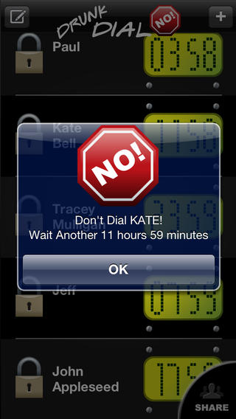
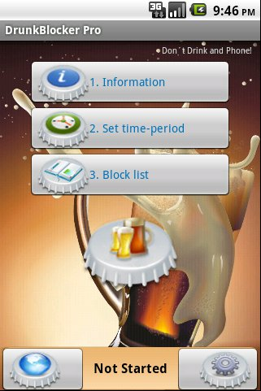
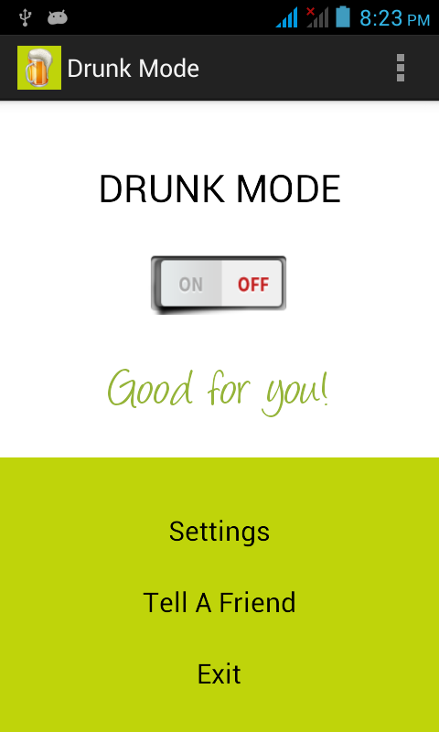
Existing Software Review
Courtesy: Drunk Dial No!
Courtesy: DrunkBlocker Pro
Courtesy: Drunk Mode

Slide 3
Requirements Gathering: Questionnaire
We analysed the existing softwares to get the basic idea for the GUI.
Requirements gathering is the practice of collecting the requirements of a system from users, customers and other stakeholders.
We’ve planned to gather requirements and user’s preferences by
“Questionnaires using Likert’s Scale technique”
Our Questionnaire Is Available At: http://goo.gl/RPBzCo

Slide 4
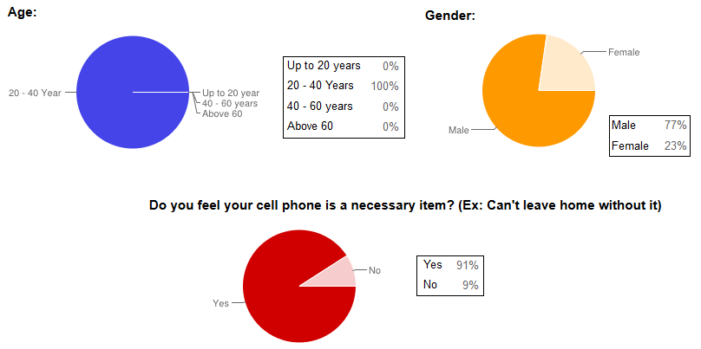
Result I : Requirement Gathering

Slide 5
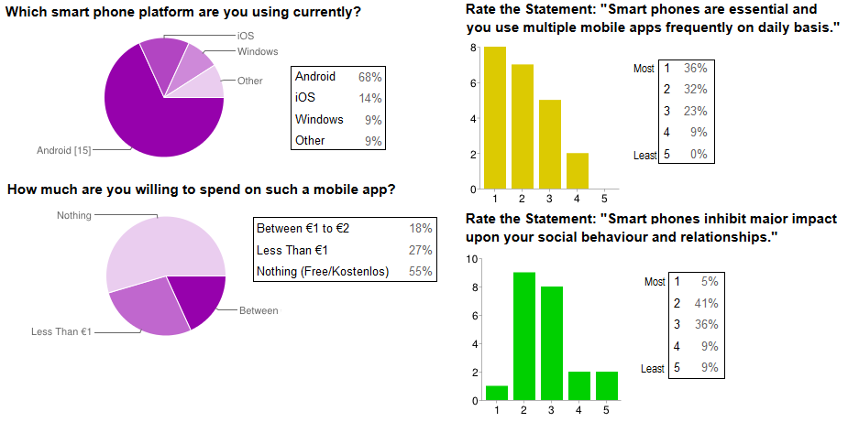
Result II : Requirement Gathering

Slide 6
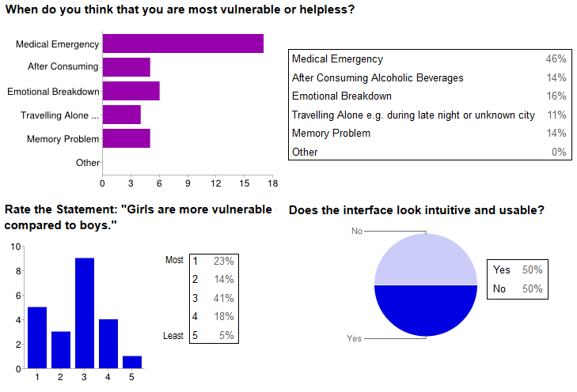
Result III : Requirement Gathering

Slide 7
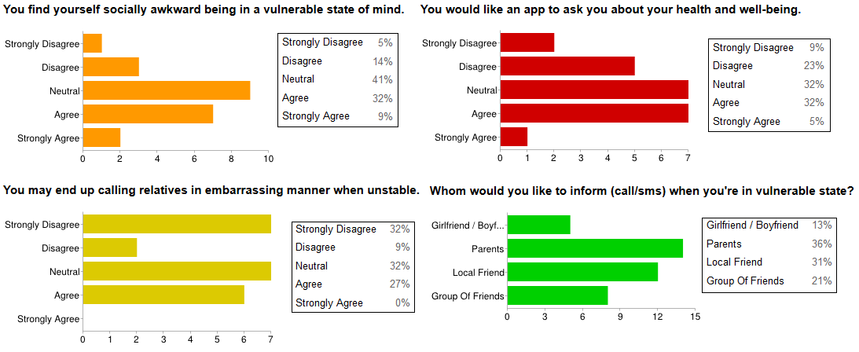
Result III : Requirement Gathering

Slide 8
Result IV: Requirement Gathering
Factors/Severity | (Lowest) 1 | 2 | 3 | 4 | 5 (Highest) | Cumulative | Score
GPS Location Sharing For Help | 1 | 0 | 4 | 8 | 9 | 90 | 4.09
Reminders Whether You're OK | 1 | 3 | 9 | 5 | 4 | 84 | 3.82
Emergency Call to Relatives | 0 | 2 | 9 | 3 | 8 | 83 | 3.77
Speed Dial Pop-up | 2 | 2 | 5 | 8 | 5 | 78 | 3.55
Sobriety Test Before Call | 3 | 4 | 4 | 5 | 6 | 73 | 3.32
Blocking Call To Boss/GFs/BFs | 3 | 3 | 5 | 7 | 4 | 72 | 3.27
Reminders About Sex/Drive | 2 | 5 | 3 | 9 | 3 | 72 | 3.27
WhatsApp Integration | 3 | 5 | 4 | 5 | 5 | 70 | 3.18
Factors/Importance | (Lowest) 1 | 2 | 3 | 4 | 5 (Highest) | Cumulative | Score
Functionality / Utility | 0 | 1 | 1 | 5 | 15 | 100 | 4.55
Look & Feel (Usability) | 0 | 1 | 5 | 9 | 7 | 88 | 4.00
Price and Others | 1 | 0 | 6 | 7 | 8 | 87 | 3.95

Slide 9
Mini SRS
Functional Requirements | Non-Functional Requirements
Sharing GPS Location With Preselected Person | GUI Must Be: Clear, Concise, Consistent, Familiar, Responsive, Efficient
Repeated Reminders About One’s Well-being | High Reliability
Automatic Emergency Call To Relatives | Interactive and Appealing UI
Speed Dial Pop-up For Taxi Service / Doctor / Police | Must follow guidelines of Android based GUIs
Sobriety Test Before Call | Multi-lingual Support
Blocking Calls to Ex-Lovers / Bosses etc. | Efficient Code Reusability

Slide 10
Basic Android UX/UI Guidelines
Real objects are more fun.
Keep it short and simple. (KISS)
Pictures are faster than words.
Only interrupt me if it's important.
Never lose my stuff.
Only show what I need when I need it.
Get to know me.

Slide 11
Context of Use
Platform: Android 4.0+ (Most Used Android API: ICS)
Technical Knowledge Needed: Very Less. App is for naïve users.
Software Development Model:
Iterative Prototype Model
User Centered Designing Model
Target Audience:
Medical Emergent People, People consuming heavy Alcohol etc.
User Design Guideline:
Pictorial Buttons would be better than textual ones because they can catch attention easily.
Application should be intuitive, otherwise it would be irritating for some mundane tasks.

Slide 12
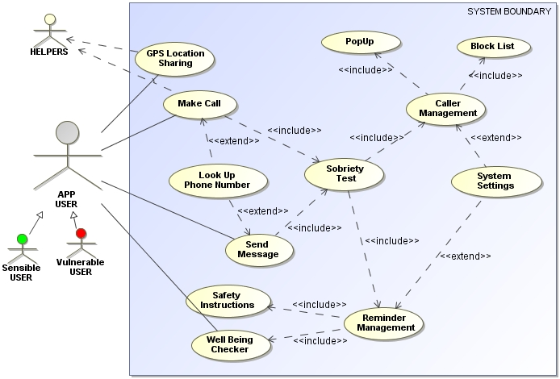
Preliminary Use Case

Slide 13

THANK YOU!!!

